Slide 1


Slide 2
INTRODUCTION TO TREASURY MANAGEMENT
Introduction to treasury Management
Treasury organization and structure
Sources of Funds
Major risk in treasury Management
Pricing of the product
Derivatives instruments
Investments portfolio and liquidity Management
Treasury Management function in Zambian Banks.

Slide 3
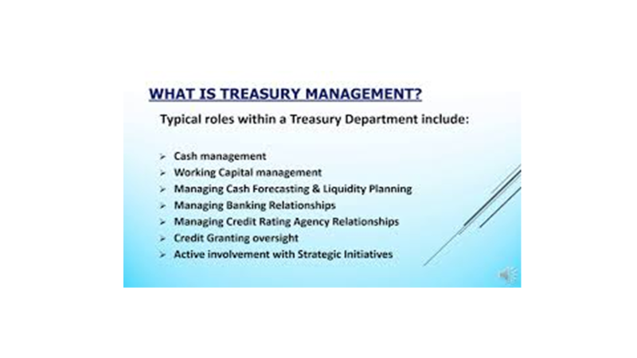

Slide 4
What is treasury and Treasury Management
Treasury refers to the funds and revenue at the disposal of the Banks/organization
The art of managing within the acceptable level of risk, the consolidated funds of the bank optimally and profitably is called Treasury Management.
The main objectives of TM are:
To ensure the availability of cash when it is needed
To minimize the cost of funds, and to optimize the returns on surplus funds.
To ensure safety of investments

Slide 5
What is Treasury and Treasury Management
Traditionally, TM was confined to Fund Management, meaning
Maintaining adequate cash balances to meet day to day requirement of bank.
Deploying surplus funds generated in operations.
Sourcing to bridge the gaps arising out of operations.
In banks, the Treasury is also responsible to meet the reserve requirements of the bank. Thus the primary function was essentially liquidity management

Slide 6
Scope of Treasury Management
In the context of Banking and Finance, the scope of Treasury Management can be broadly categorized as follows:
Liquidity Management
Money Market Management
Capital Market Management
Correspondence Banking
Foreign Exchange Management
Rate Determination.

Slide 7
LIQUIDITY MANAGEMENT
The objective of liquidity management is to maintain adequate level of liquidity and raise profitability of the bank managing the surplus liquidity.
In the situation of surplus liquidity, the treasury should use in money market lending, reserve repo, buying T-bills, and government securities.
In case of deficit of liquidity, the treasury should go for any of the interbank borrowings, borrowing against T-Bills and bond or debentures, repos.

Slide 8
MONEY MARKET TRANSACTIONS
Money market is a market where short term securities with high liquidity are traded.
It is used as a means for borrowing and lending in the short term basis. i.e. up to one year.
The investment in Treasury bills shall be done for the purpose of maintaining statutory liquidity ratio and managing returns and liquidity.
The treasury department will purchase the treasury bills within the approved limits.

Slide 9
Capital Market Transactions
Capital Markets these are markets where long term securities are traded. In capital Markets , long term debt and equities are traded such as bonds, equities.
This type of market is composed of both Primary and Secondary markets.
Treasury department shall make the long term investments in capital market instruments like government bond, corporate bonds, preference shares and equity shares.
These investments should be done through primary as well as secondary markets.

Slide 10
Corresponded Banking
Corresponce Banking refers to a banking relationship between two banks, where one bank provides banking services to another bank, allowing the respondent banks to access services in foreign markets. Situations in which used:
International payment
Trade finance-LC BGs
Foreign currency Transactions
Clearing services
Access to Financial Markets-Expansion of Business
Risk Mitigation- Risk associated with international transactions such as compliance with local Laws.

Slide 11
Foreign Exchange Management
The foreign exchange market or forex market as it is often called is the market in which currencies are traded.
This is because the value of one currency is determined by comparison to another currency.
The first currency of a currency pair is called the Base Currency, while the second currency is called the quote currency. EUR/USD = 1.1286, here EUR is base currency and USD is quote currency and this quote implies EUR is 1 and USD 1.1286.
The currency pair shows how much of the counter currency is needed to purchase one unit of the base currency.

Slide 12
Rate Determination
Treasury should use two way pricing system to publish rates.
Normally, price is determined freely on the basis of the market forces of demand and supply
Dealers are responsible for issuing daily exchange rates of each convertible foreign currency.
These are fixed against Zambian kwacha at the start of the business day
The spread of buying and selling rate would be as determined by the authority
Dealers will issue revised rates during the business hours if market conditions change significantly.

Slide 13
Principles of TM
Principles of security
Principles of Liquidity
Principles of Profitability
Principles of Portfolio

Slide 14
Principles of Security
The banks should invest the investible funds in safe or secure areas in which default risk will be minimum.
Because banks should refund the peoples money at their demand or after certain periods of time mentioned in the contract

Slide 15
Principles of Liquidity
The basic objective of liquidity management is to maintain adequate level of liquidity to meet borrower and depositors demands.
The bank will create such assets which can be liquidated when required.

Slide 16
PRINCIPLE OF PROFITABILITY
The investment made by banks should provide the maximum returns possible
Banks main objective is to maximize profit since it is profit making business.

Slide 17
Principle of portfolio
Portfolio is the combination of investments in two or more than two financial assets.
The objective of the portfolio is to maximize the risk or diversification of risk
The treasury department should invest in the portfolio of various assets with the objective of the risk mitigation.

Slide 18
Roles and Function of TM
Cash forecasting
Working capital Management
Cash Management
Investment Management
Treasury risk Management
Management advise
Credit Rating Agency Relationship
Bank relationships
Fund raising
Credit granting

Slide 19
Cash forecasting
The accounting staffs generally handles the receipt and disbursement of cash, but the treasury staffs need to compile this information for short term and long term forecasts.
These forecasts are needed for investments purposes, so the staffs can plan to use investments vehicles that are of the correct durations to match scheduled cash outflows.
The staff also uses the forecasts to determine when more cash is needed, so that it can plan to acquire funds either through the use of debt or equity.

Slide 20
Working Capital Management
This involves managing the day to day operations of an organization, including, the management of accounts payable and receivable, inventory level and other short term assets and liabilities.
The treasurer should be aware of working capital levels and trends and advise management on the impact of proposed policy changes on working capital level.

Slide 21
Cash Management
This involves forecasting cash flows, managing bank relationships, and making investment decisions to optimize the use of cash resources.
The treasury staff uses the information it obtained from its cash forecasting and working capital management activities to ensure that sufficient cash is available for operations needs.

Slide 22
Investment Management
The treasury staff is responsible for the proper investment of excess funds.
The maximum return on investments of these funds is reraly the primary goal.
Instead, it is much more important to not put funds at risk and also to match the maturity dates of investment with a company projected cash needs

Slide 23
Treasury Risk Management
The interest rates that a company pays on its debt obligations may vary directly with the market rates, which present a problem if market rates are rising.
A company’s foreign exchange positions could also be at risk if exchange rates suddenly worsen
In both cases, the treasury staff can create risk management strategies and implement hedging tactics to mitigate the company risk

Slide 24
Management advise
The treasury staff monitors market confidence constantly and therefore is an excellent inhouse resource for the management team should they want to know about on.
Interests rates that the company is likely to pay on new debt offerings
The availability of debt and probable terms that equity investors will want in exchange for their investments in the company

Slide 25
Credit Rating Agencies Relation
When a company issues marketable debt, it is likely that a credit rating agency will review the company’s financial well being/condition and assign a credit rating to the debt
The treasury staff responds to information requests from the credit rating agency’s review team and provides it with additional information over time.

Slide 26
Bank Relations
The treasurer meets with the representatives of any bank that the company transacts with to discuss the company financial conditions, the banks fee structure, any debt granted to the company by the bank and other services such as foreign exchange transactions, hedges wire transfers.
A long term and open relationships can lead to some degree of bank cooperation if a company is having financial difficulties and may sometime lead to modest reductions in bank fees.

Slide 27
Fund Raising
A key function of treasurer is to maintain excellent relation with the investment company for fund raising purposes.
This community is composed of the sell side which are those brokers and investment bankers who sell the company’s debt and equity and other sources of cash, who buy the company’s debt and equity.
While all funds ultimately come from the buy side and the sell side in the valuable for the contacts with the buy side, and therefore is frequently worth the cost of its substantial fees associate with fund raising.

Slide 28
Credit Granting
The granting of credit to customers can lie within scope of the treasury departments or may be handed off to the accounting staffs.
This task is useful for the treasury staff to manage since it allows the treasurer some control over the amount of working capital locked up in accounts receivables.

